Slide 1
The Effect of the Current Drought on the Colorado River
For Water Data Analytics
Spring 2022

Slide 2
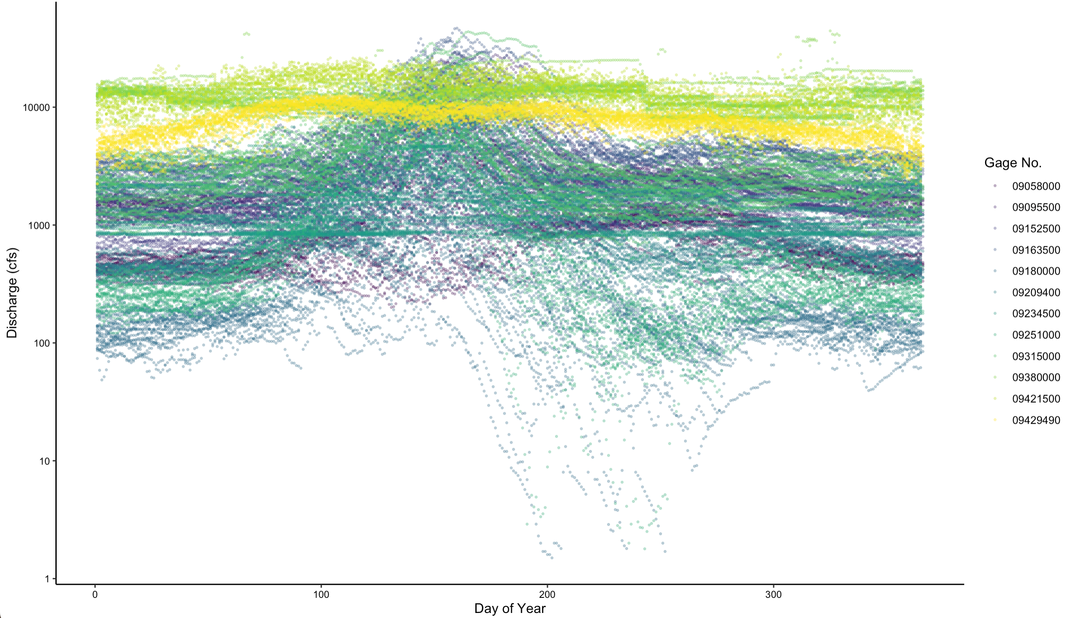
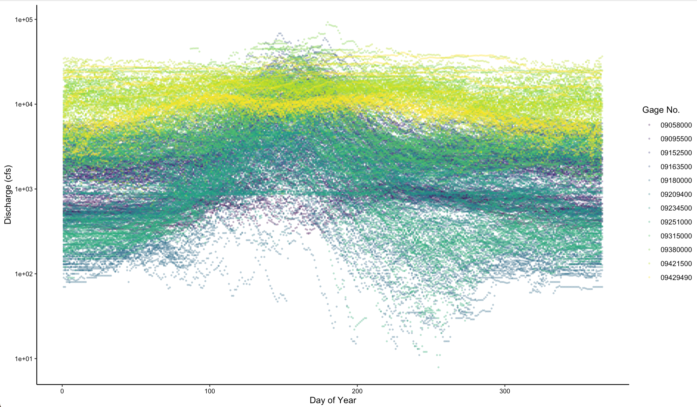
Discharge

Slide 3
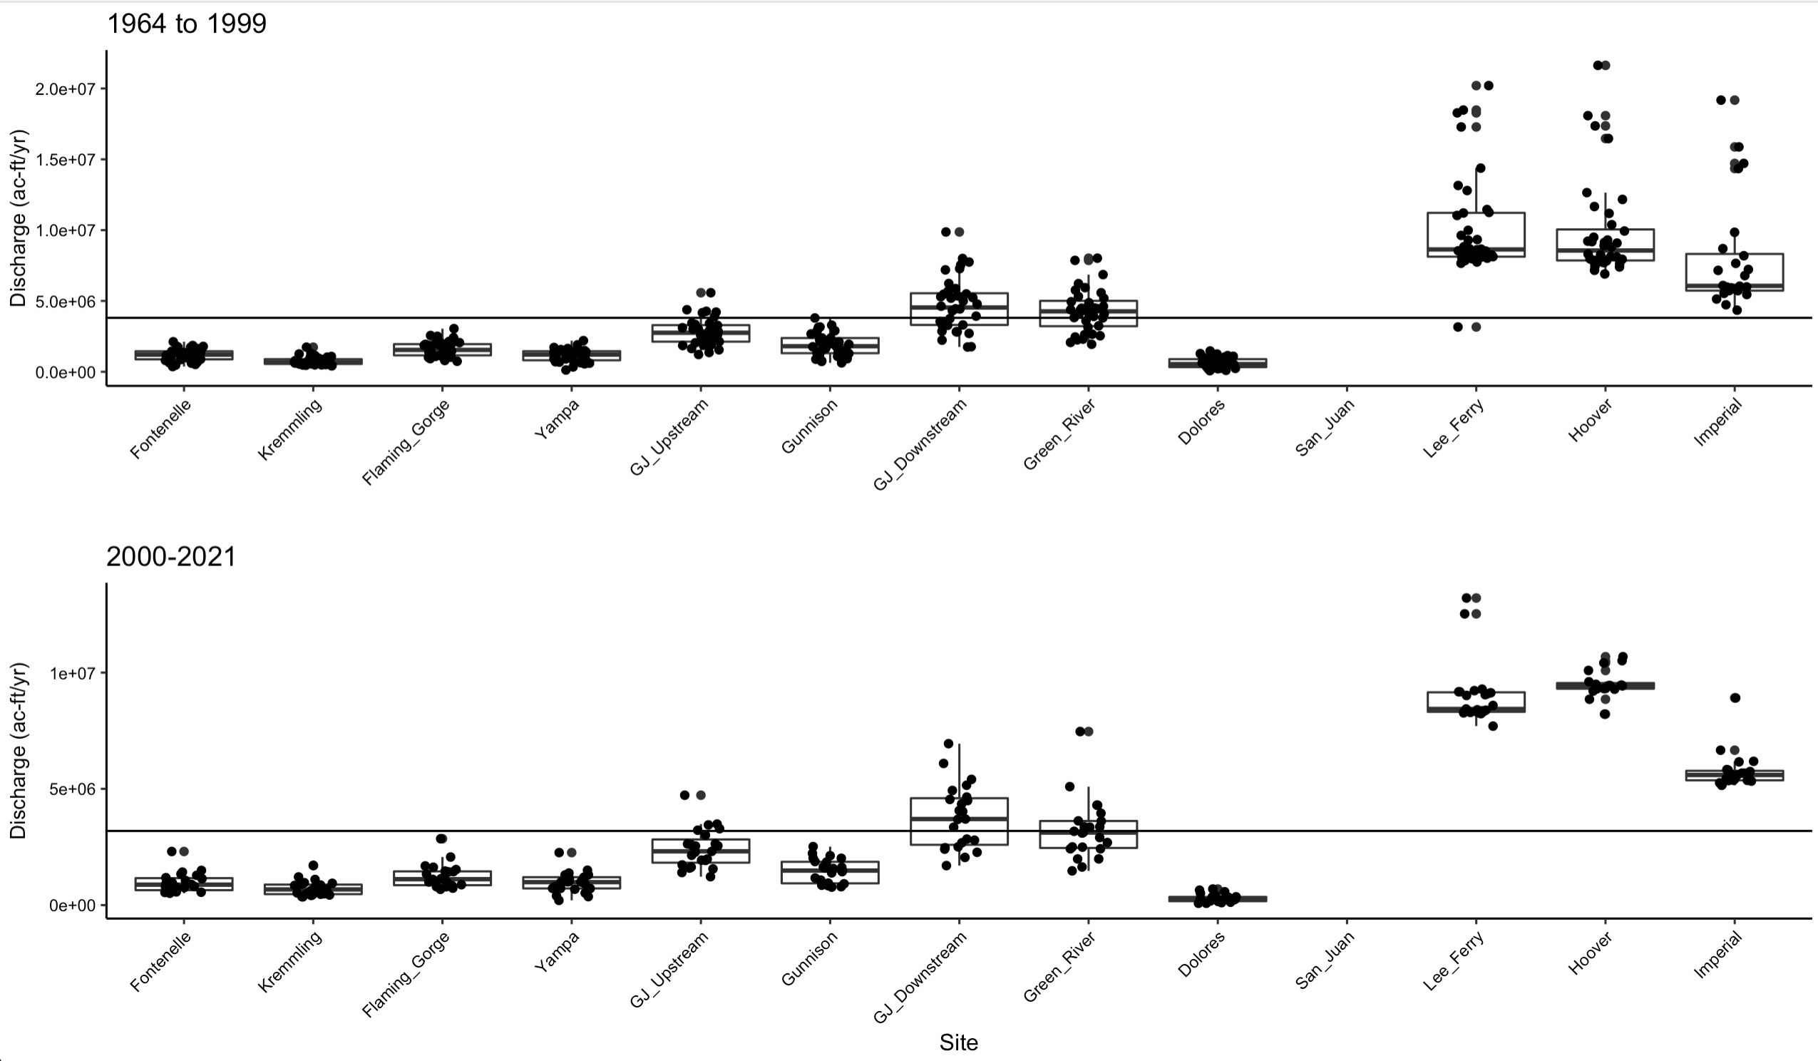
Discharge
Average 1964-1999:
3,807,857 ac-ft/yr
Average 2000-2021:
3,189,017 ac-ft/yr

Slide 4
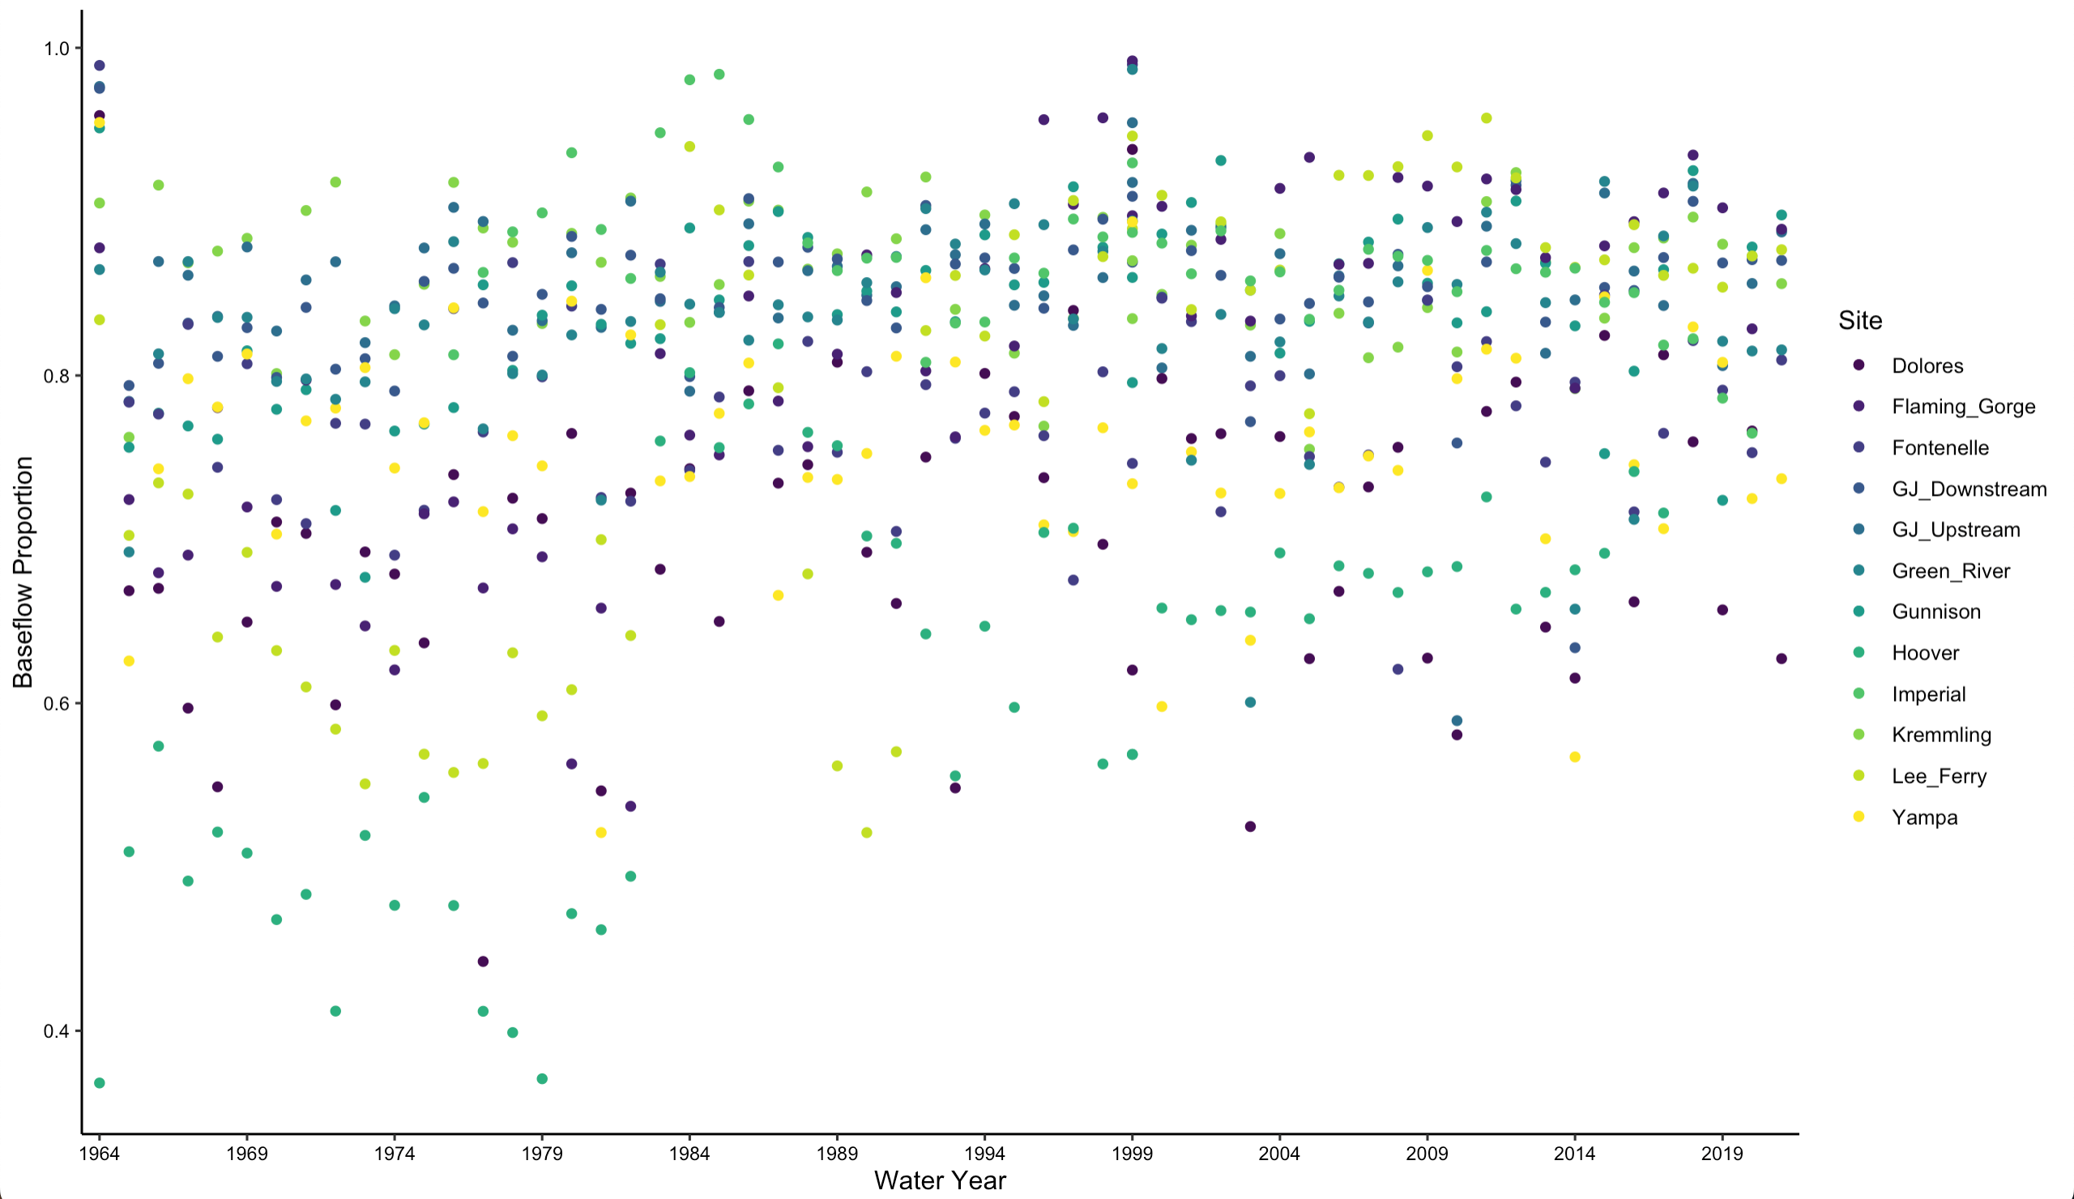
Baseflow
Increase in the proportion of baseflow over time
1964-1999:
Average 0.78
2000-2021
Average 0.82

Slide 5
Summary
Discharge has changed significantly with the drought
Average annual discharge is about 18% lower during the current drought
The proportion of discharge made up by baseflow has increased
Increased by 4 percentage points during the drought
The effects of drought are easily visible and quanitifiable even in this scratch-on-the-surface look at the river

Slide 6

Questions?

